Slide 1
WEARABLE HEALTHCARE
Alistair, Ana-Maria, Daniel, Joe, Rose & Vidya
Notes:
Basic introduction of the group

Slide 2
Project Statement
Design a battery powered wearable healthcare device. It should be able to monitor vital signs (ie. blood pressure, heart rate and body temperature) and signal for help when these levels are in dangerous zones.
The devices only need to be able to detect changes in readings that indicate an issue rather than accurate readings throughout.
The signal will be transmitted via radio to the local healthcare providers to indicate that there is a healthcare emergency.
Notes:
Vidya: Vital signs (blood pressure, heart rate, body temperature and breathing rate) are essential in order to assess the general physical health of a person, and can be used in combination to identify possible diseases, as well as indicate a person’s progress towards recovery.

Slide 3



Target demographic
Communities in remote parts of the world
Vulnerable individuals i.e. prenatal, elderly
Low Income countries - 40% of women experience complications at birth
https://www.who.int/bulletin/volumes/93/4/14-140996/en/
Notes:
Rose:
For monitoring the health of individuals in remote parts of the world where access to healthcare is limited
Could apply to antenatal and postnatal care for pregnant women
In low-income countries, almost 40% of women experience complications after delivery, according to WHO (World Health Organisation).

Slide 4
Project timeline
Week 1
Week 2
Week 3
Week 4
Project selection
Construction and improvements.
Adjustments and presentation.
In depth research and design.

Slide 5
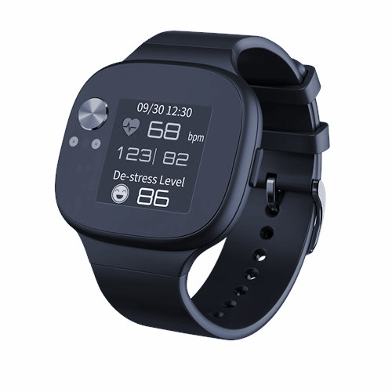
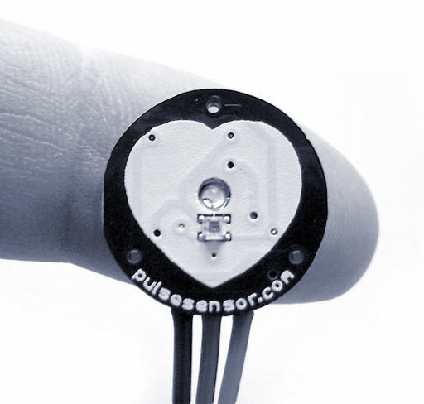
Heart Rate
The two main methods of measuring heart rate are photoplethysmography (PPG) and electrocardiography (ECG)
We will use PPG which is found in most modern watches, and uses optical sensors to detect pulses
We aim to take measurements from the radial artery
The Asus Vivowatch BP is able to measure both heart rate and blood pressure using a combination of ECG and PPG
Notes:
Joe: There are currently two main methods that are used to measure heart rate. These are through Photoplethysmography and Electrocardiography.
PPG is the most common out of the two, and utilises green LEDs to illuminate the skin whilst measuring the changes in light absorption. We aim to source a small device that has an integrated optical pulse detection circuit (of which there are plenty available), and will place it on the radial artery.
We also discovered that the Asus Vivowatch BP is able to measure both heart rate and blood pressure using a combination of ECG and PPG, so we are going to look into this further during the project.

Slide 6
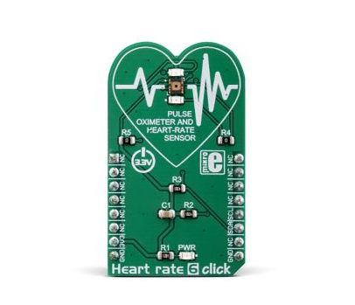
Oxygen Content
Photoplethysmography can be used to determine the oxygen content in the blood
Near infrared spectroscopy (NIRS) processing techniques can be used to measure the levels of oxygenated, reduced and total haemoglobin [1]
The PPG sensor performs a dual function of heart rate and oxygen content monitoring
Notes:
Ana-Maria: Photoplethysmography (PPG) is an optical technique that measures blood volume variations. The PPG waveform contains other significant physiological information that can be used in conjunction to SpO2 for the assessment of oxygenation and blood volumes changes. This paper investigates the use of near infrared spectroscopy (NIRS) processing techniques for extracting relative concentration changes of oxygenated, reduced and total haemoglobin from dual-wavelength PPG signals during intermittent pressure-increasing vascular occlusions. [2]

Slide 7
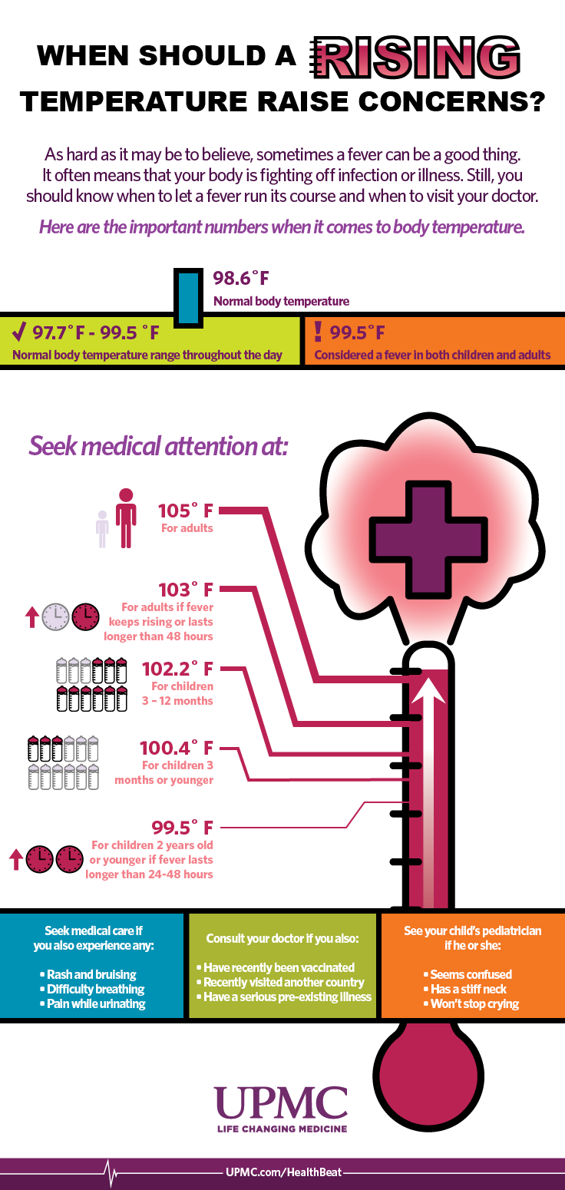
Temperature
01
Skin temperature
Consider the range of temperatures which are medically safe/not safe.
02
Component choice
Comparison of thermistor, thermocouple, infrared sensor and digital.
03
Data required
Considered measuring change in temperature or absolute temperature
Notes:
RH. It was important to know what temperatures are considered healthy and not to understand the requirements of the problem. Human body temperature is fairly universal, and there are very specific temperatures at which medical attention Normal: 36.5–37.5 °C (97.7–99.5 °F) Fever: >37.5 or 38.3 °C (99.5 or 100.9 °F) Hypothermia: <35.0 °C (95.0 °F). Because of this, we will not hopefully have to consider calibration.
For component choice, we compared a thermistor, a thermocouple, an infrared sensor and a semiconductor integrated circuit.
Thermistor and thermocouple appear to be the simplest options to integrate.
Thermistor - in particular NTC which appears to be highly accurate, high immunity to noise may be important if several components. Output requires linearisation. Potential to put in wheatstone bridge for further improved accuracy.
Thermocouple - also requires linearisation of output and susceptible to calibration drift and reduced accuracy - best for high temp applications.
Infrared sensor - useful for non contact thermometers, but requires PWM.
Semi-conductor based sensors - easier to program as offer a linear response, but lowest accuracy - this is a problem because we need to obtain absolute values.
For the data required, we spent some time figuring out whether we wanted to detect the change in temperature, or the absolute temperature. Whilst a change in temperature is potentially more easy to design for, as the ambient temperature should not affect it, as the health guidelines stipulate absolute temperatures at which medical health should be sort, and hence this would be more useful information. We will need to consider taking the absolute value, but only reporting as an emergency if this absolute temperature is sustained for a determined length of time.

Slide 8
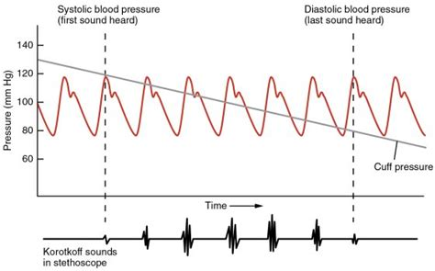
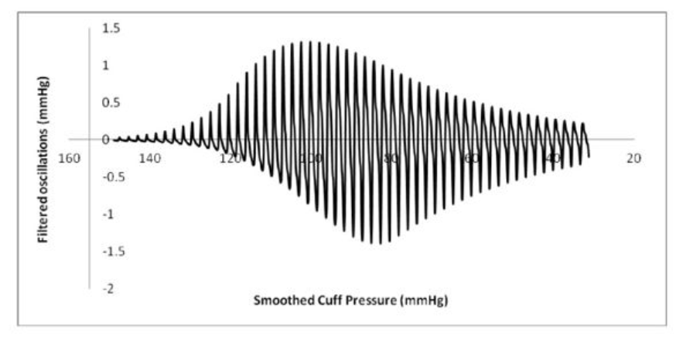
Blood pressure
Blood pressure is conventionally measured using a sphygmomanometer
A cuff is fitted over the arm and tightened until the artery is completely occluded
Three different ways of measuring pressure as the cuff is deflated [2]:
Palpation
Korotkoff sounds
Oscillometric method
Notes:
DAN
Occlusion - imagine pinching shut flexible tube
The pressure in the cuff when blood first passes through the cuffed region of the artery is an estimate of systolic pressure (maximum pulsatile pressure). The pressure in the cuff when blood first starts to flow continuously is an estimate of diastolic pressure (minimum pulsatile pressure).
Palpation: Appearance of a distal pulse indicates cuff pressure has dropped just below systolic pressure - doesn’t tell you diastolic
Korotkoff sounds: Turbulence as blood spurts into the expanding artery causes pulses of sound - first sound is indicator of systolic pressure. As cuff pressure drops between systolic and diastolic regular “thumping” is heard as the blood pressure oscillates around the cuff pressure. When the cuff pressure drops below the diastolic pressure, just have normal laminar flow - silence indicates diastolic pressure
Oscillometric method: Measure cuff pressure, high pass filter to extract the small oscillations due to pulsatile flow. Can extract estimates of blood pressure from the envelope of this function.

Slide 9
Measuring blood pressure in practice
Restrict blood flow.
Measure the pressure applied
Measure the blood pressure variation
Acoustic sensor - Korotkoff sounds
Pressure sensor - Oscillometric method
Notes:
Normally done using an inflatable cuff. Current units go up to approximately 300mmHg. Would need to come up with a different solution in order to be compact enough to fit in a watch.
Pull band to which slowly releases.
Sensors like force sensitive capacitors, - capacitance changes with force applied. extremely small and accurate. Plug into an Arduino
Most complicated part is measuring blood pressure variation. Would need to do some testing before deciding which is most effective - Korotkoff sounds would potentially be simpler, but we would need to guarantee that the acoustic sensor picks up the sounds as well at the wrist as at the arm. Currently requires trained doctor to listen for the sounds.
Pressure sensor would be more accurate and consistent, but need to understand the algorithm properly for extracting the systolic and diastolic pressure from the envelope wave form.

Slide 10
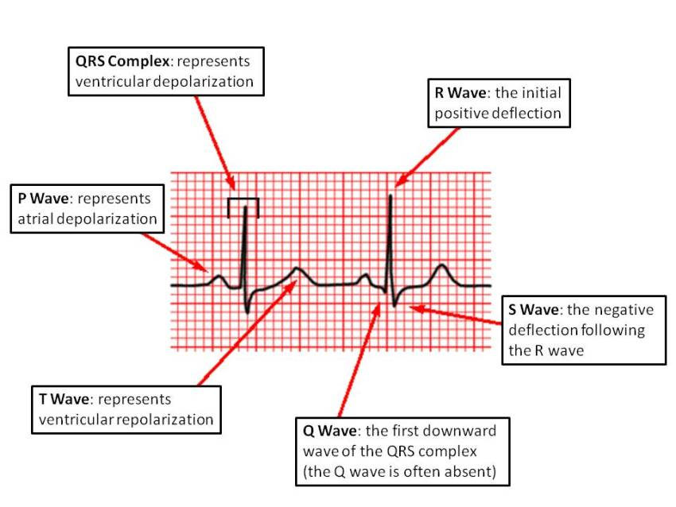
No cuff measurement
Pulse transit time .
ECG and PPG.
Could give indication of acute pressure change.
Notes:
Pulse transit time refers to the time it takes a pulse wave to travel between two arterial sites
Speed pulse travels is directly related to blood pressure.

Slide 11
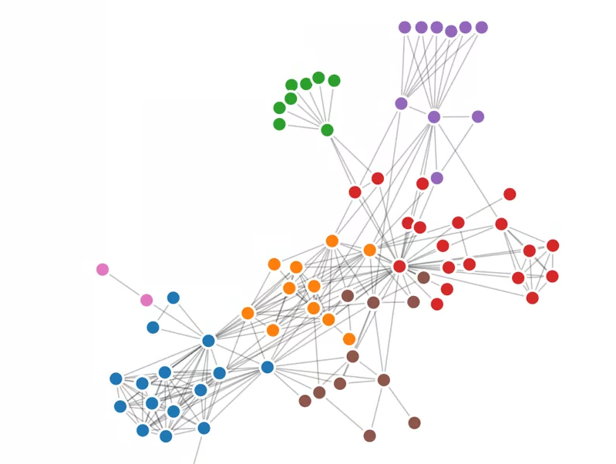
Combining the data
Each individual component may have low accuracy.
Combining the data together can give much clearer indication of problems.

Slide 12
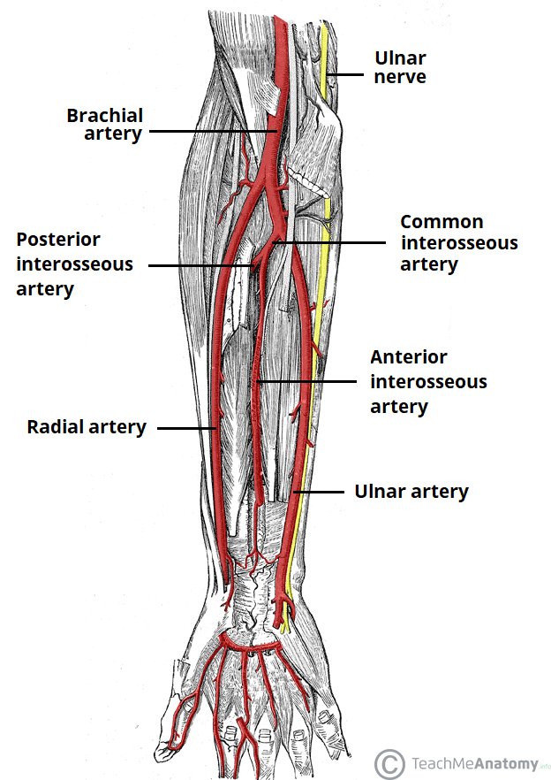

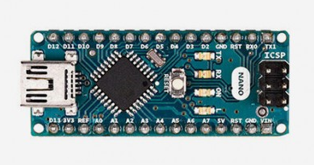
Mechanical design
Controlled by an arduino nano (potential for a smaller microcontroller to be implemented in further iterations)
We will use an arduino uno for simplicity in the design stage
Blood pressure sensor located on the radial artery
Heart rate sensor located on the ulnar artery
Temperature sensor located mid-wrist
Components initially attached using a velcro strap
Power in the final design provided by wrist motion
Notes:
Ana-Maria: All of the electrical components that we plan to use will be controlled by an arduino circuit board. For simplicity in the initial design phase, we aim to use an arduino uno. Our team already has experience with Arduinos, and they are compatible with a wide range of devices. In the future, further iterations of the wearable healthcare tracker could utilise an arduino nano that is significantly smaller than the uno, or even a microcontroller that is smaller than that.
Joe: With regards to the location of sensors, research articles have shown that the novel pressure sensing technique that we aim to use works well when located on the radial artery. This is shown here on the diagram, and is located above the thumb. For the heart rate sensor, we aim to use the other main artery that runs through the wrist, the Ulnar artery shown here. The location of the temperature sensor is less defined than the other two, and will be determined during testing.
We plan to initially attach all components to a strip of velcro, and have the arduino controller located externally. In the final design, we believe it would be possible to use wrist motion to provide power, as found in some modern watches.

Slide 13
Potential Problems
01
Short Time Frame
02
Ergonomics
03
Integration of Different Components
04
Blood Pressure Sensor
05
Measurements
06
Skill sets
Notes:
Vidya: Short Time Frame: Three weeks is a very short amount of time. Time management will be critical to ensure there is a working device at the end. A key aim is to ensure we produce a product that is functional enough to allow a future team to continue work on it. It’s also important to prioritise what we want to build ourselves vs. what we’re happy to use existing sensors for instead.
Ergonomics: The design must be practical in terms of comfort for the user and accuracy of measurements. This will require careful mechanical design and consideration of material choices. They must be considerate of the local culture and require minimal instruction. It shouldn’t hinder daily activities as they will be less likely to use it then.
Integration of Different Components: The sensors for heart rate and temperature are well established so once the appropriate circuit is identified our main difficulty will be ensuring they all work well together. This will be in terms of the electrical circuit compatibility and ensuring it is low power and doesn’t use too much board space
Blood Pressure: Blood pressure monitors of any size have a range of issues that need to be considered. This is made more difficult by the need to make the device compact. This will be our main challenge for the project.
Measurements: It will be important to understand the level of accuracy required in each sensor. The aim is to identify only when critical values have been exceeded so it is important to balance accuracy, cost and size to optimise the design for the user needs.
Skill Sets: Our skill sets are all quite similar with a lot of mechanical specialisations. Acquiring the additional skills in the three weeks will be crucial to our success so this must be dealt with efficiently.

Slide 14
Thank you!

Slide 15
Questions

Slide 16
Bibliography
[1]: Abay, T. Y., 2018, Photoplethysmography for blood volumes and oxygenation changes during intermittent vascular occlusions. Accessed Online https://www.ncbi.nlm.nih.gov/pmc/articles/PMC5943414/ [05.16.2019]
[2]: Babbs, C. 2012, Oscillometric measurement of systolic and diastolic blood pressures validated in a physiologic mathematical model. BioMedical Engineering Online, https://biomedical-engineering-online.biomedcentral.com/articles/10.1186/1475-925X-11-56

